Slide 1
ACI Guide
090415

Slide 2
Initial Setup
Connections
Initial config
Fabric discovery

Slide 3
Connections
Standard topology for all:
  Spines connect to all Leafs
  Leafs connect to all Spines
  Spines never connect to another spine
  Leafs never connect to another leaf
  Predictable latency
  All nodes 3 hops away from each other.
Use 40G QSFP for Spine-Leaf links
Use 10G for links from Leafs to nodes

Slide 4
Initial config
APIC comes in a UCS C-series server
Connect a usb keyboard and VGA monitor to view CLI for initial setup.
Configure password for admin
Configure IP address/default gateway
Once done, connect laptop on Eth1 and browse thru https://192.168.10.1

Slide 5
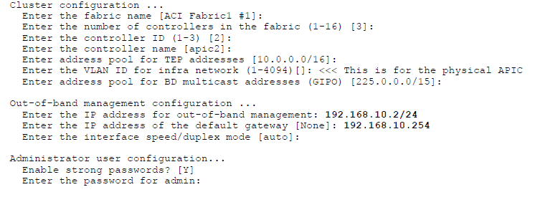
Initial configs

Slide 6
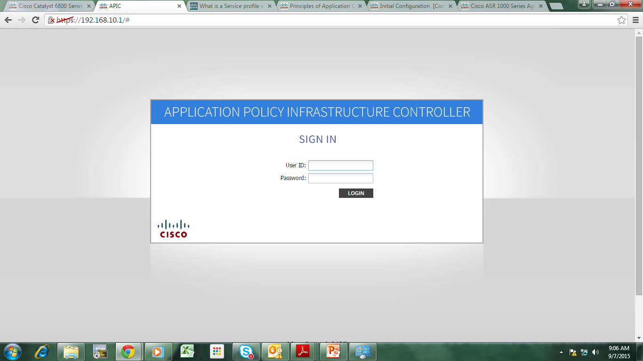
ACI GUI Login

Slide 7
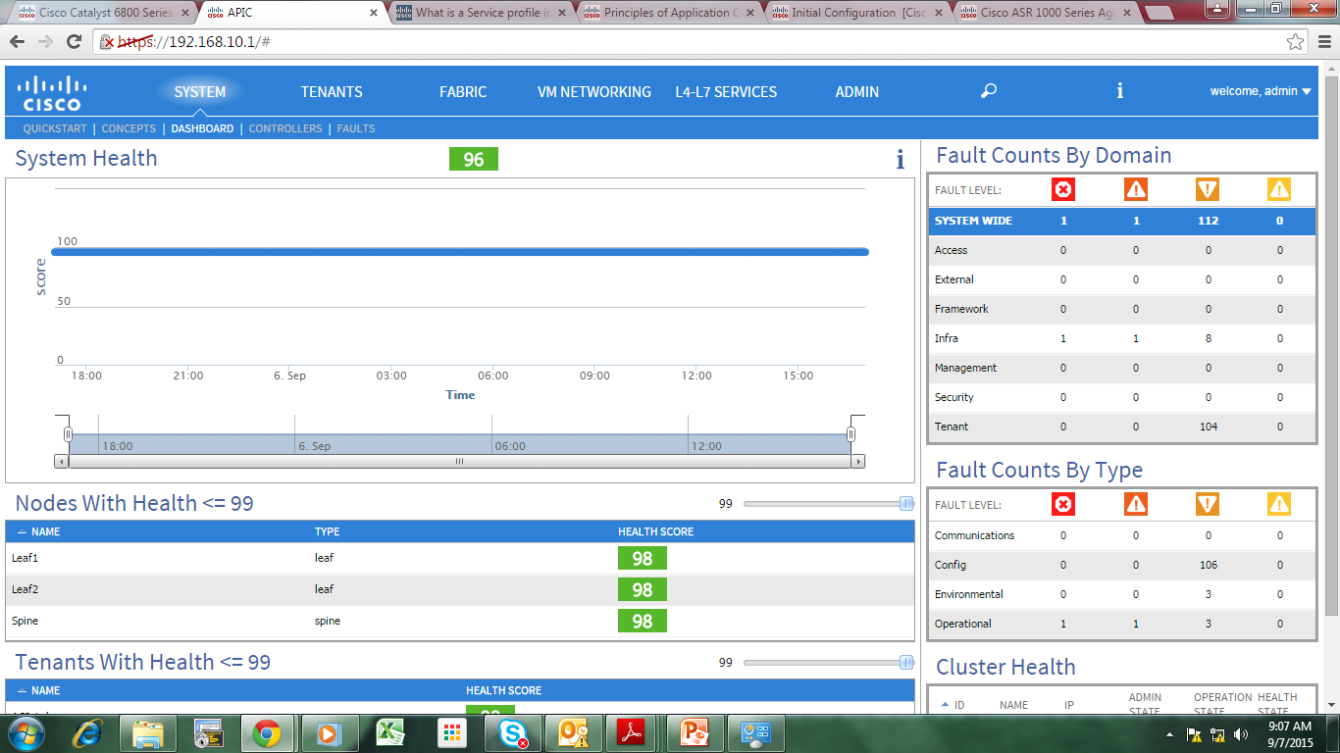
ACI Dashboard

Slide 8
FABRIC

Slide 9
Fabric Inventory

Slide 10
Fabric Discovery
Click on FABRIC
Click on Inventory submenu
Click Fabric Membership

Slide 11
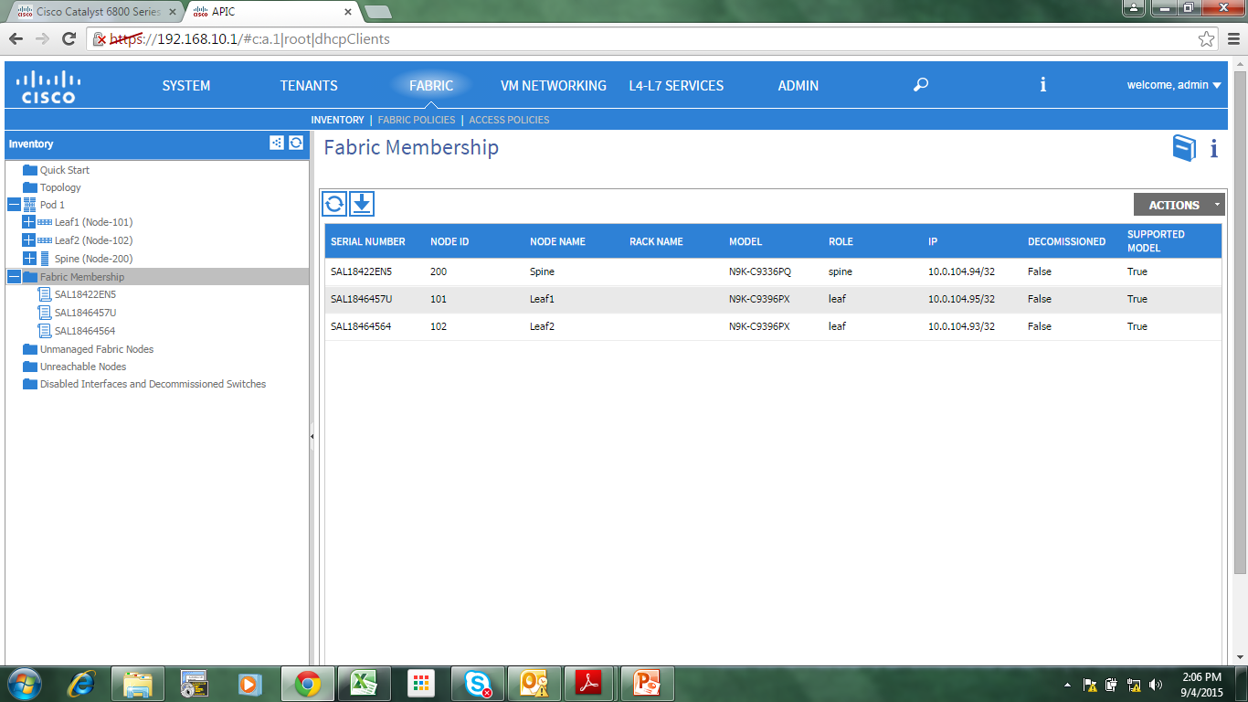
Fabric Discovery

Slide 12
Fabric Discovery
By default, if interfaces are up, ACI should discover Leafs (thru cdp/lldp) and Spines, and other APIC in the network.
Set the Node ID (any unique number)
Set the Node name (any name)

Slide 13
Fabric Access Policies

Slide 14
Vlan Creation
Click FABRIC
Click Pools
Click VLAN
Click Actions (or right click)
Click Create VLAN Pool

Slide 15
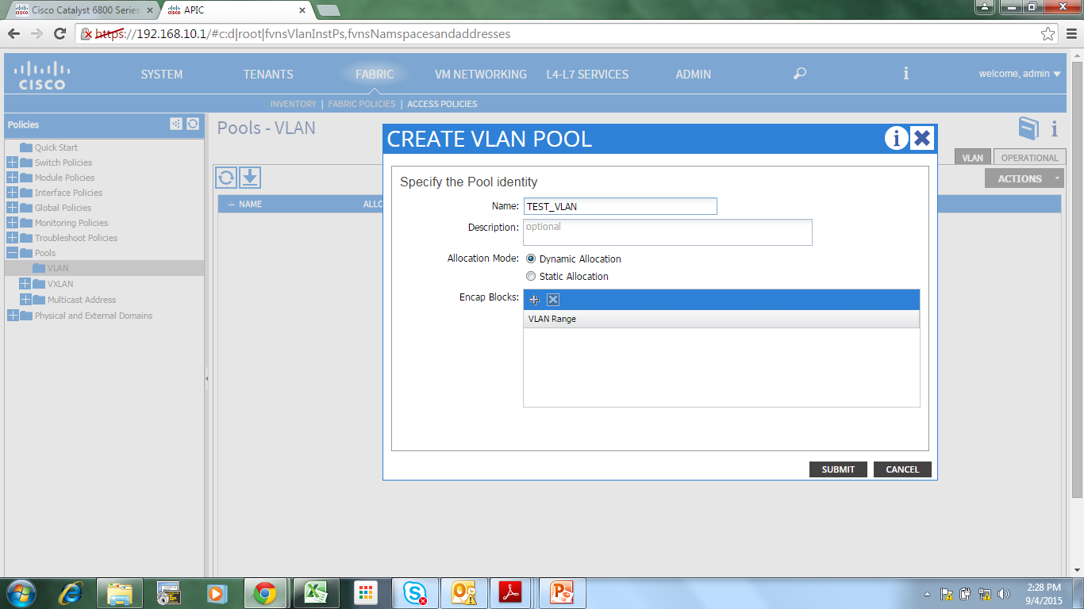
VLAN Creation

Slide 16
VLAN Creation
Set VLAN name
Click “+” under Encap Blocks
Click Submit

Slide 17
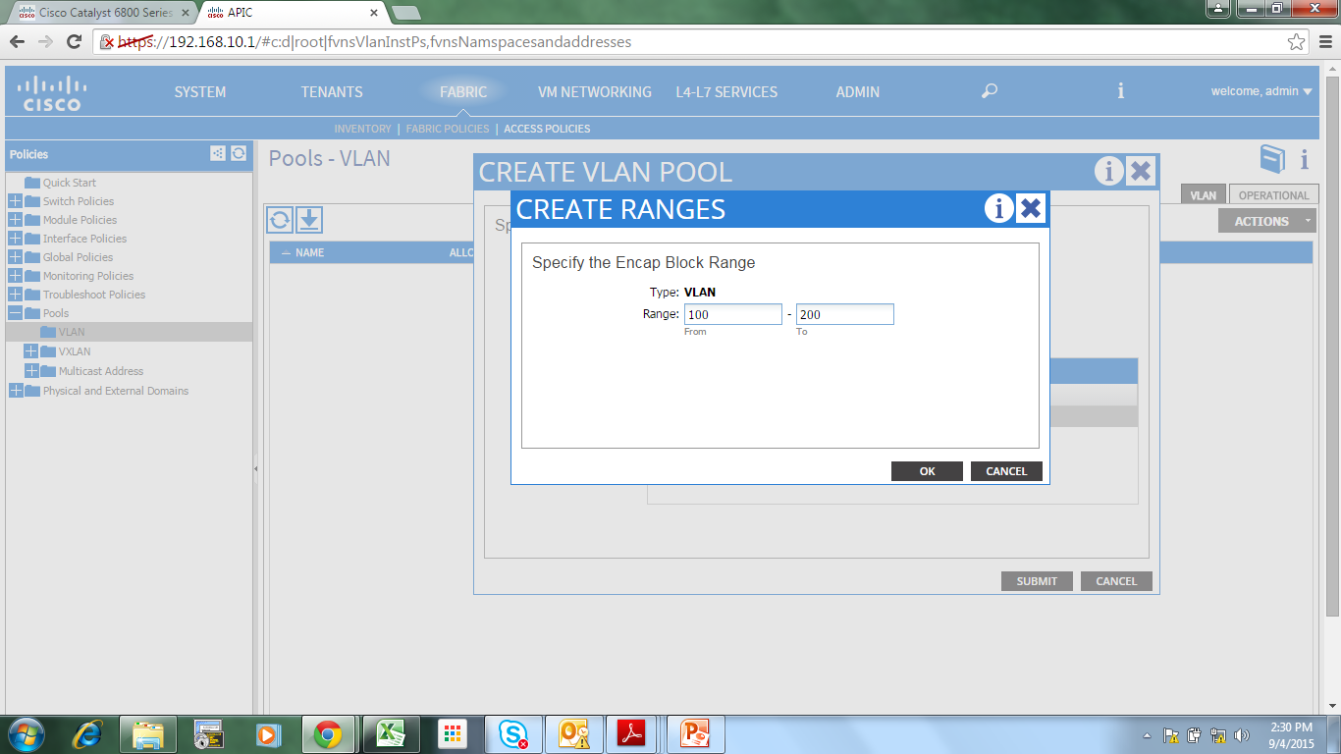
VLAN Creation

Slide 18
Create Physical Domain
Physical Domain = For connecting to outside non-ACI network
Click FABRIC
Click Access Policies
Click Physical and External Domains
Click Physical Domains
Click Actions (or right click)
Click Create Physical Domain

Slide 19
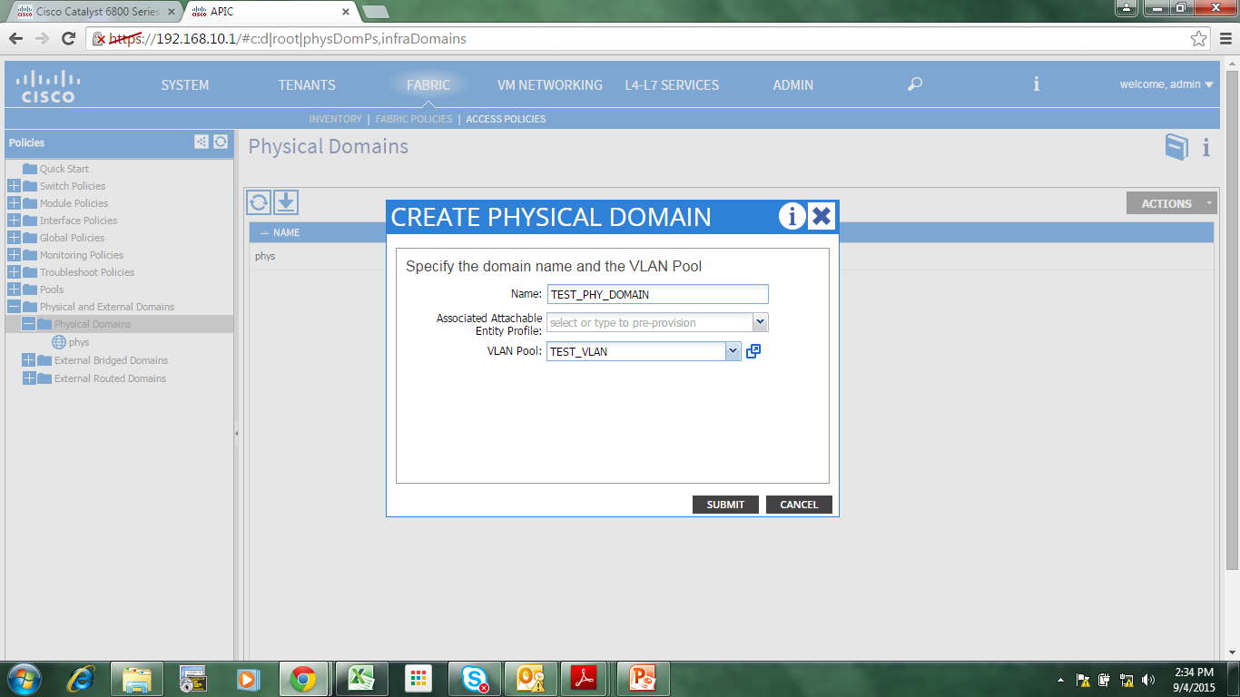
Create Physical Domain

Slide 20
Create Physical Domain
Set name
Select the VLAN Pool created earlier
Click Submit

Slide 21
Create Interface Policy Group
Interface Policy Group = Port-profiles in NX-OS
Click FABRIC
Click Access Policies
Click Interface Policies
Click Policy Groups
Click Actions (or right click)
Click Create Access Port Policy Group

Slide 22
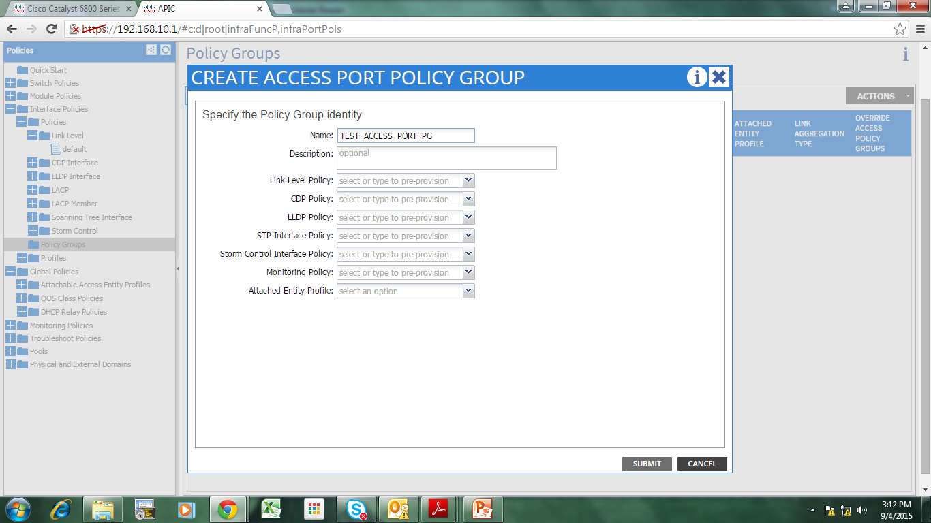
Create Interface Policy Group

Slide 23
Create Interface Policy Group
Set name
Click Submit

Slide 24
Create AAEP
AAEP – Attachable Access Entity Profile
AAEP = groups together Physical, Virtual and External Domains

Slide 25
Create AAEP
Click FABRIC
Click Access Policies
Click Global Policies
Click AAEP
Click Actions (or right click)
Click Create AAEP

Slide 26
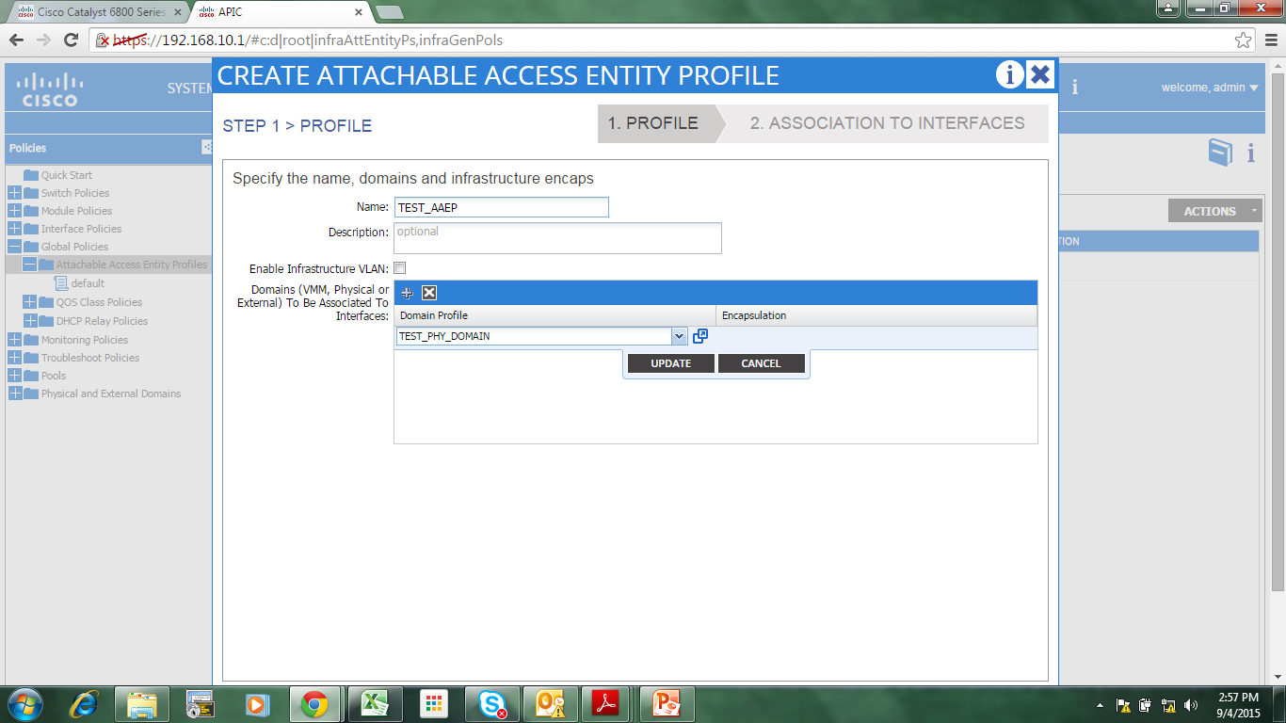
Create AAEP

Slide 27
Create AAEP
Set name
Select the Physical Domain you created earlier.
Click Update
Click Next

Slide 28
Create Interface Profile
Interface Profile -> inside is Access Port Selector.
Access Port Selector = interface range
Click FABRIC
Click Access Policies
Click Interface Policies
Click Profiles
Click Actions (or right click)
Click Create Interface Profile

Slide 29
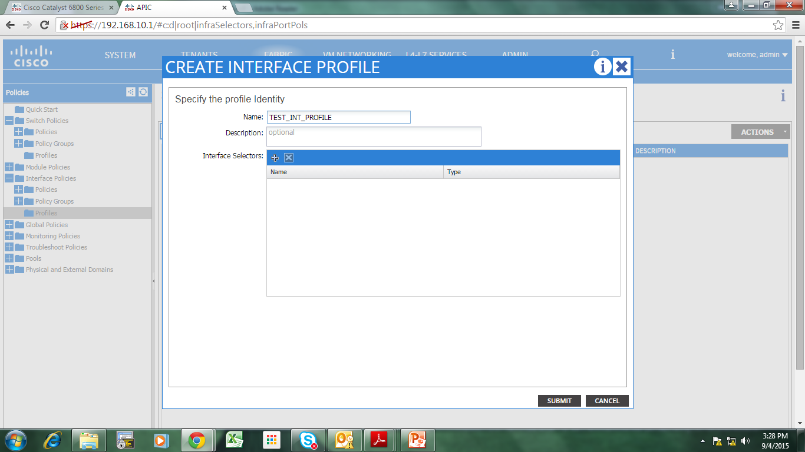
Create Interface Profile

Slide 30
Create Interface Profile
Set name
Click “+” on Interface Selectors

Slide 31
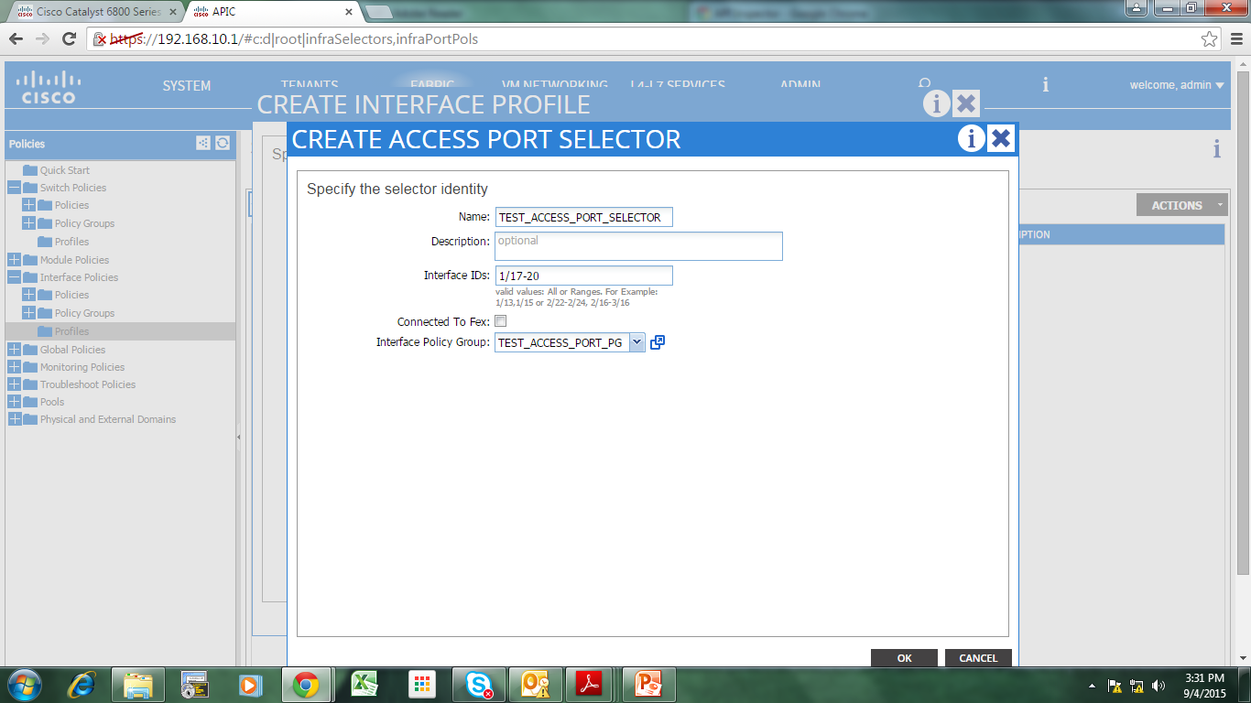
Create Access Port Selector

Slide 32
Create Access Port Selector
Set name
Set access ports from N9K
Set Interface Policy Group created earlier.
Click OK
Click Submit

Slide 33
Create Switch Profile
Switch Profile -> inside is Switch Selector
Switch Selector = Leaf/Spine selector (for same configs/policies)
Click FABRIC
Click Access Policies
Click Switch Profiles
Click Profiles
Click Actions (or right click)
Click Create new switch profile

Slide 34
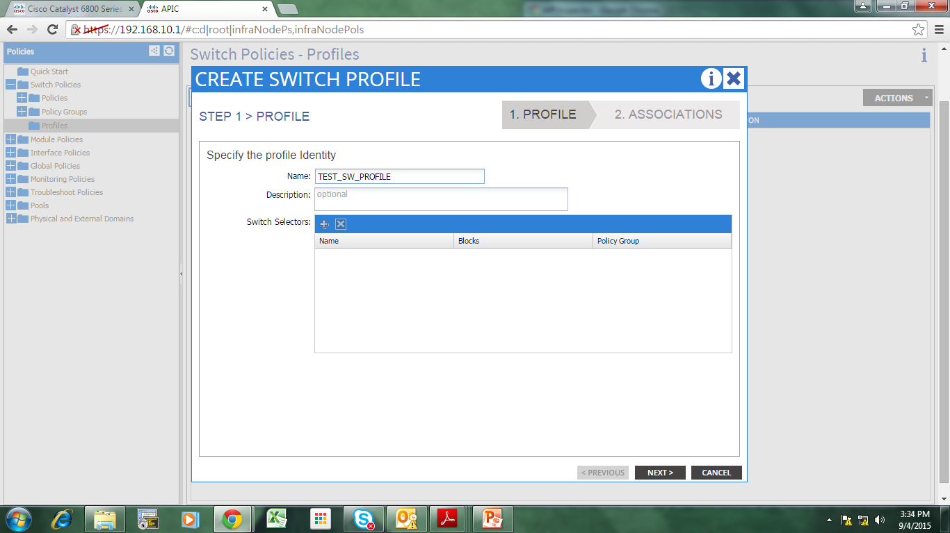
Create Switch Profile

Slide 35
Create Switch Profile
Set name
Click “+” on Switch Selectors
Set name
Set Blocks (select leaf node(s))
Click Next

Slide 36
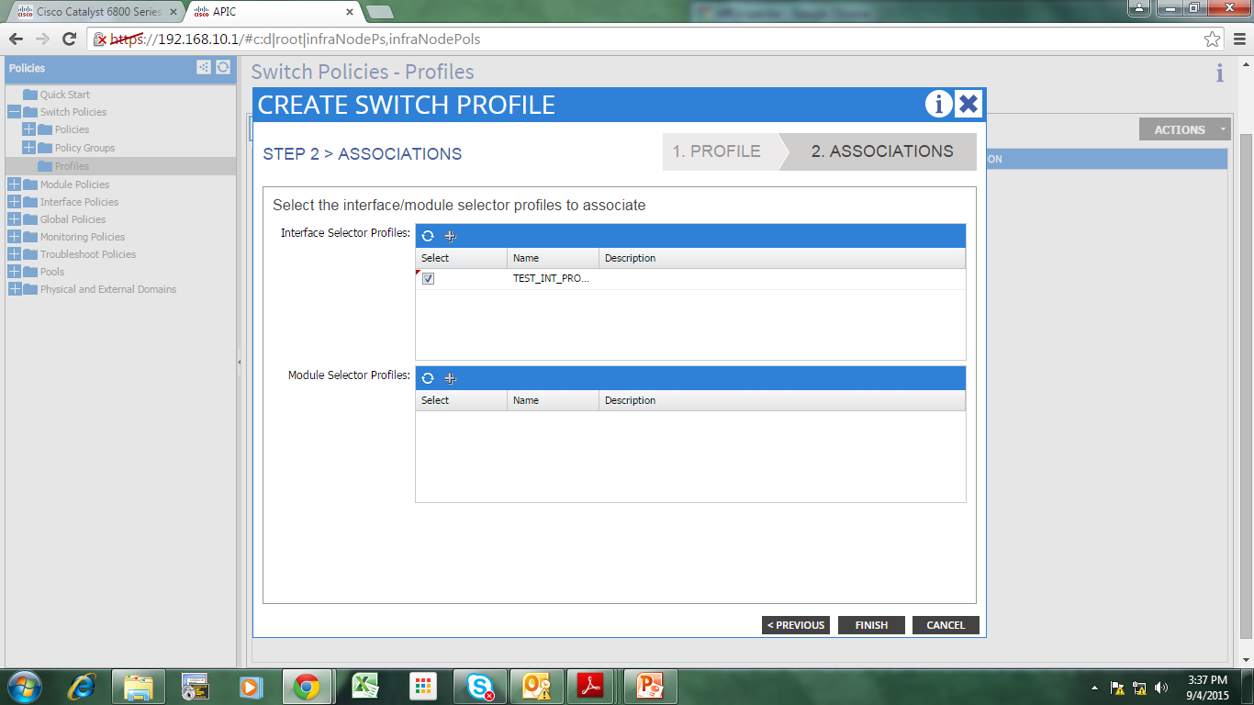
Create Switch Profile

Slide 37
Create Switch Profile
Tick the Interface Profile you created before.
Click Finish

Slide 38
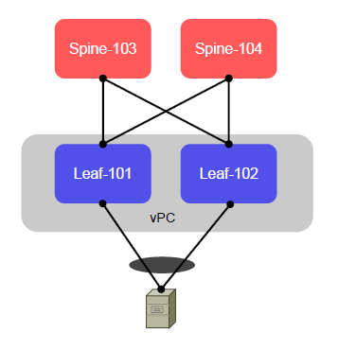
Creating a vPC on Leafs

Slide 39
Creating a vPC on Leafs
Note: There will never be a peer-link here.
Any device that has capability for port-channel can form vPC with the Leafs.
FEX can only connect to a Leaf as of this moment (no vPC+/E-vPC).

Slide 40
Defining vPC Domain
Click FABRIC
Click Access Policies
Click Switch Policies
Click Virtual Port Channel default
Set description
Click “+” on Explicit VPC Protection Groups

Slide 41
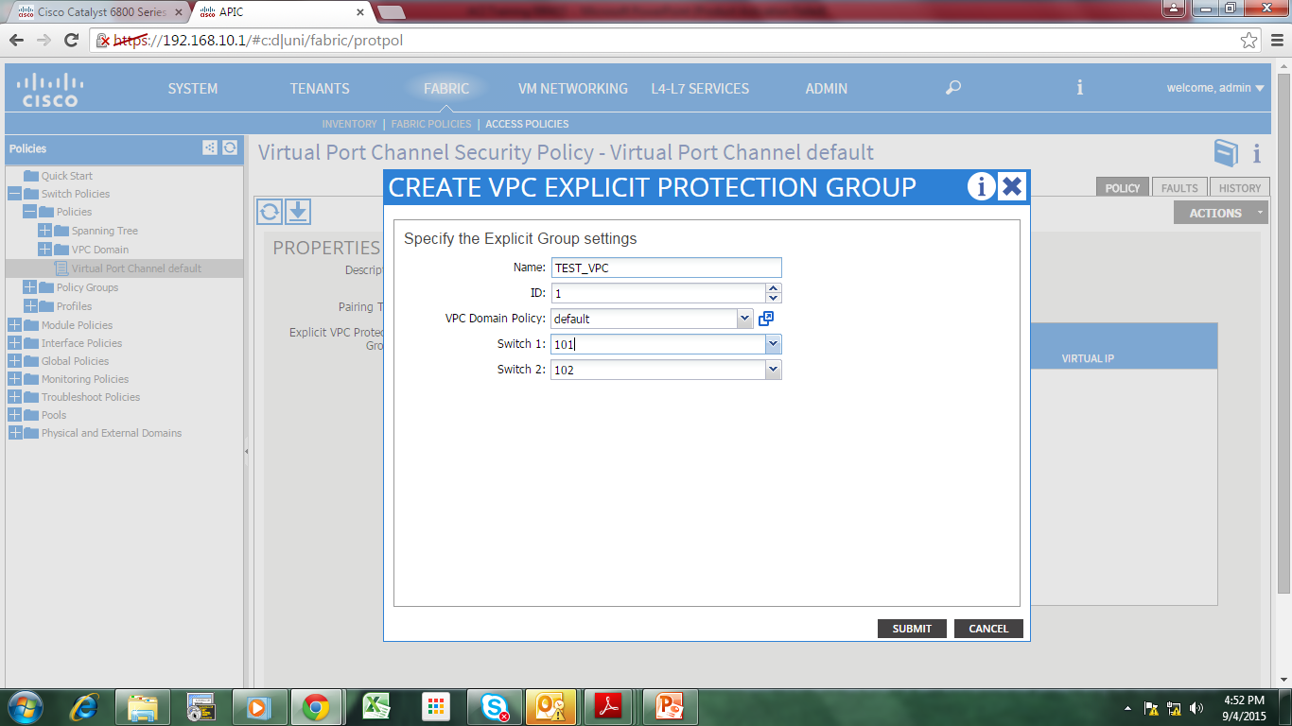
Defining vPC Domain

Slide 42
Defining vPC Domain
Set VPC domain name
Set VPC domain ID
Set “default” on VPC Domain Policy
Select the 2 Leafs which will use vPC
Click Submit
Click Submit

Slide 43
Defining vPC Domain
Click FABRIC
Click Inventory
Click Pod 1
Click Leaf #
Click Interfaces
Click VPC interfaces
Click port #

Slide 44
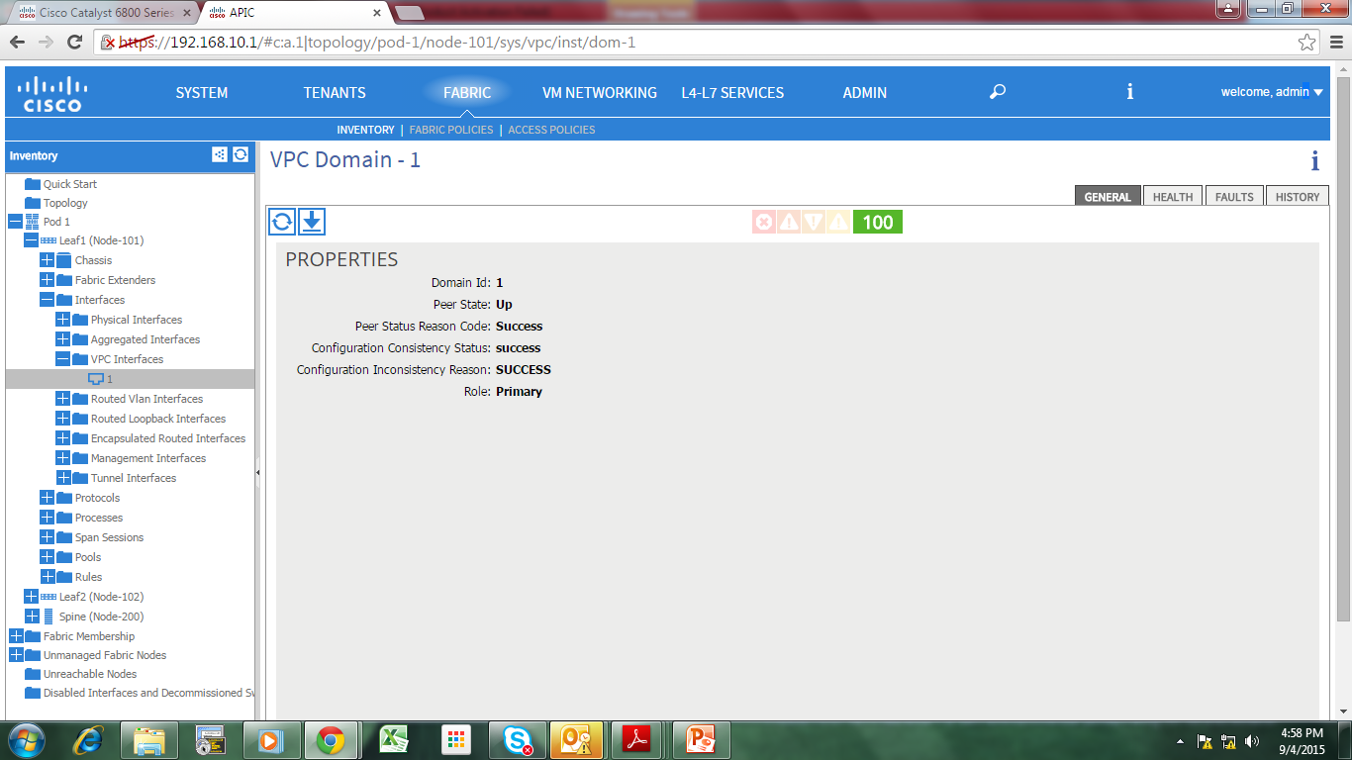
Verify vPC domain

Slide 45
Configuring the vPC port on the Leaf

Slide 46
Create vPC interfaces
Click FABRIC
Click Interface Policies
Click Actions (or right click)
Click Configure Interface, PC, and VPC
Click the green “+” sign

Slide 47
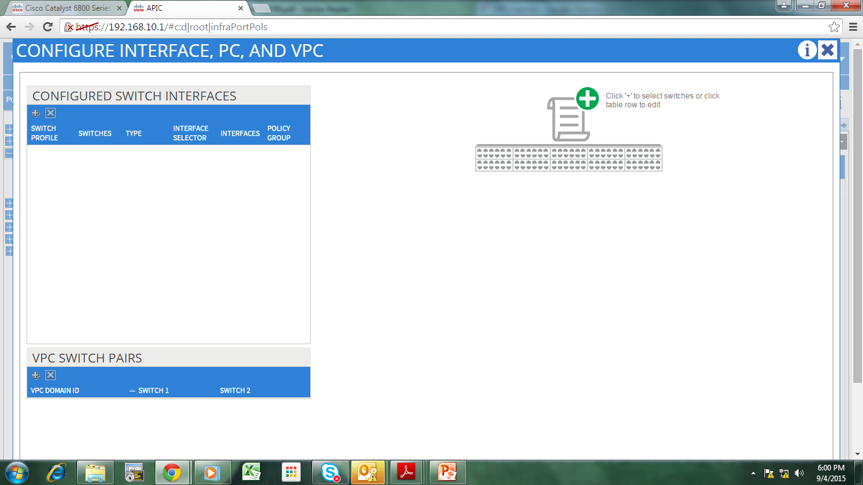
Create vPC interfaces

Slide 48
Create vPC Interface
Select Advanced mode:
Set Leaf# that will be used
Set Switch Profile name
Select VPC as interface type
Set interface no. (48/96-port)
Set interface selector name
Select vPC Policy Group created earlier
Click Save
Click Save

Slide 49
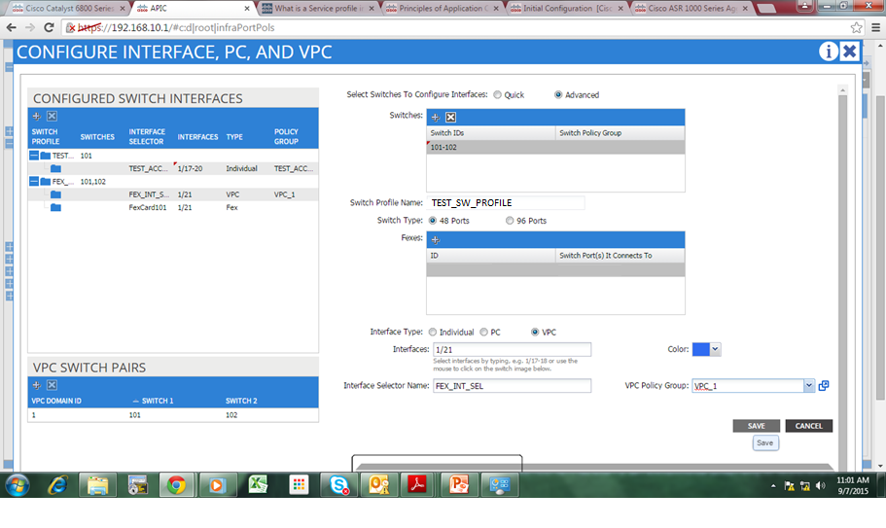
Create vPC Interface

Slide 50
Individual/Port-channel(PC)
Same procedure applies when connecting a Normal Port-channel, just tick the PC, instead of vPC.
Same procedure also for single link connection, tick the individual instead of PC/vPC.

Slide 51
Configuring Leaf port connecting to a FEX

Slide 52
Create FEX Profile
FEX Profile -> Inside is FEX Interface Selector
Interface Selector -> Group of interfaces
Click FABRIC
Click Access Policies
Click Interface Policies
Click Profiles
Click Actions (or right click)
Click Create FEX Profile

Slide 53
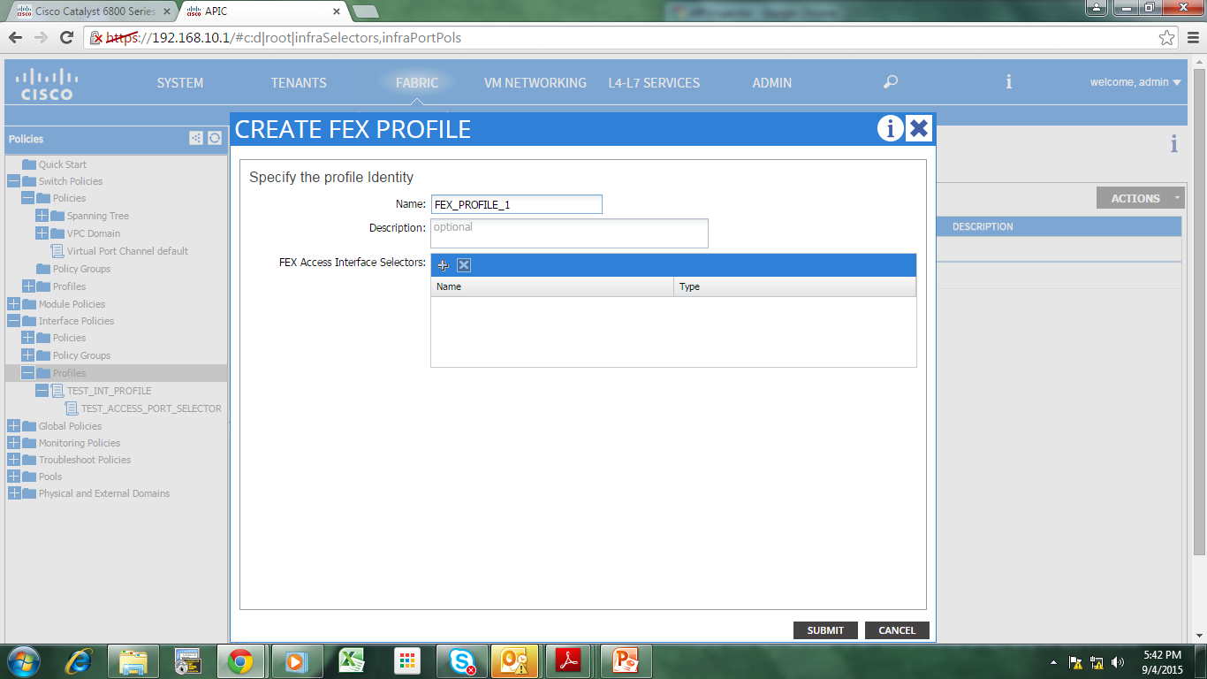
Create FEX Profile

Slide 54
Create FEX Profile
Set name
Click “+” on FEX Access Interface Selectors

Slide 55
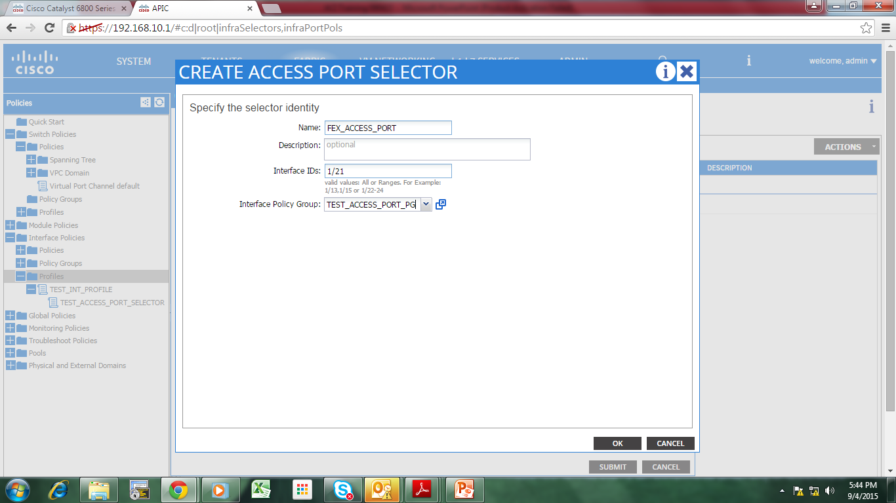
Create FEX Profile

Slide 56
Create FEX Profile
Set name
Set interface ID
Set Interface Policy Group
Click OK
Click Submit

Slide 57
Create vPC interfaces
Click FABRIC
Click Interface Policies
Click Actions (or right click)
Click Configure Interface, PC, and VPC
Click the green “+” sign

Slide 58
Create vPC interfaces

Slide 59
Connect a FEX to a Leaf
Select Advanced mode:
Set Leaf# that will be used
Set Switch Profile name
Set FEX# & port on Leaf that it will connect to
Ignore the green “+” sign (this is for non-fex switch/server connection)

Slide 60
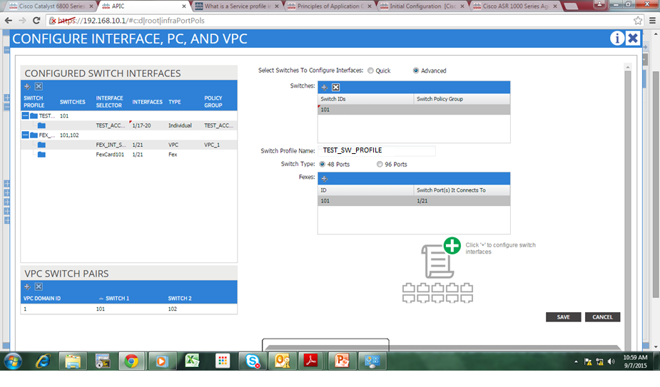
Connect a FEX to a Leaf

Slide 61
Verify FEX Connectivity
Click FABRIC
Click Inventory
Click Pod 1
Click Leaf #
Click Fabric Extenders
Click Fex 101

Slide 62
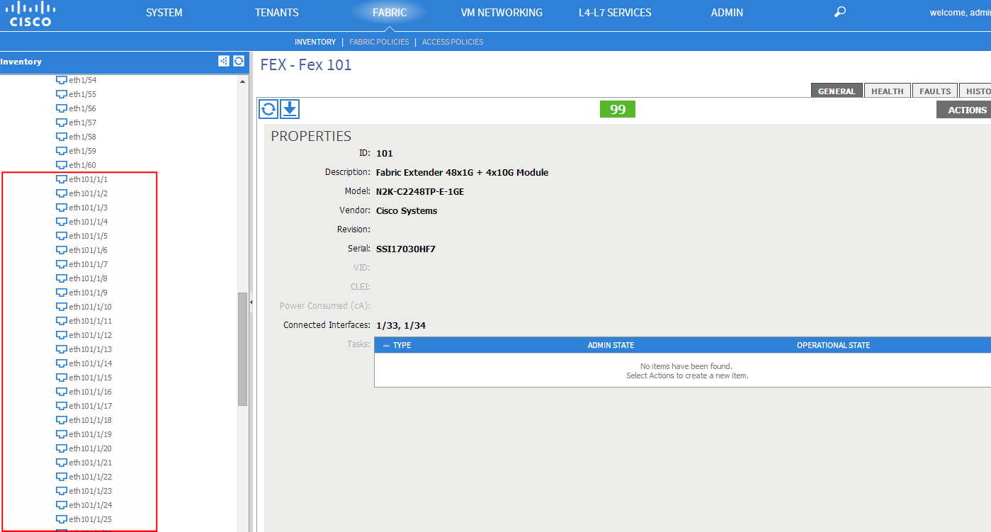
Verify FEX Connectivity

Slide 63
Verify FEX Connectivity
Click Fabric
Click Access Policies
Click Switch Profiles
Click Profiles
Check the FEX you created
Click Interface Policies
Click Profiles
Check the interface profile

Slide 64
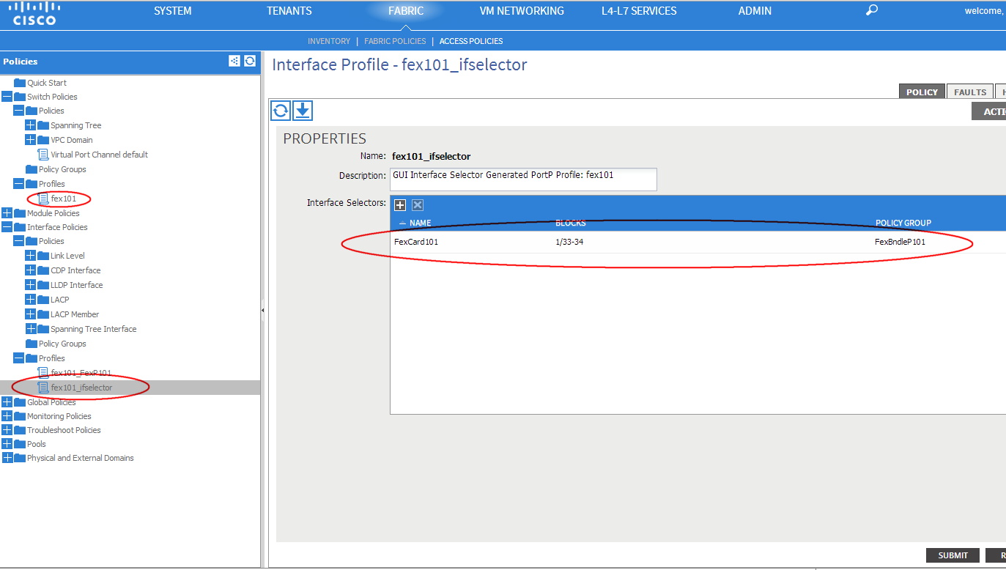
Verify FEX Connectivity

Slide 65
Currently Supported FEX models
2248Pq
2248TP-E
2248TP
2232PP
2232TM-E
B22Dell-P
B22HP-P
B22IBM-P
*As of April 2015

Slide 66
Tenants

Slide 67
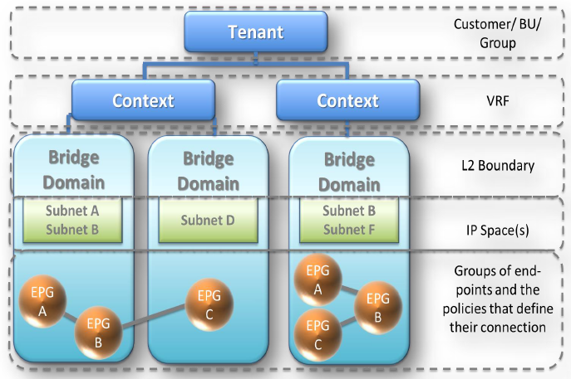
Tenant Tree Model

Slide 68
Tenant Tree Model
ACI can have multiple Tenants (Clients)
A Tenant can have more than 1 Context/VRF
A Context/VRF can have more than 1 Brigde Domain
A Bridge Domain can have more than one EPG
An EPG can have more than one End Point.

Slide 69
Tenant Tree Model
Similarly, an End Point cannot belong to more than 1 EPG.
An EPG cannot belong to more than 1 BD.
A Bridge Domain cannot belong to more than 1 Context/VRF.
A Context/VRF cannot belong to more than 1 Tenant.

Slide 70
Inter-VRF communication will require NAT for overlapping subnets.
Bridge-domain refers to flooding domain only.
EPGs under same and different BD can talk to each other as long as they have the proper contract.
Inter-tenant -> not possible as of this moment???

Slide 71
Adding a new Tenant
Click TENANTS
Click ADD TENANT

Slide 72
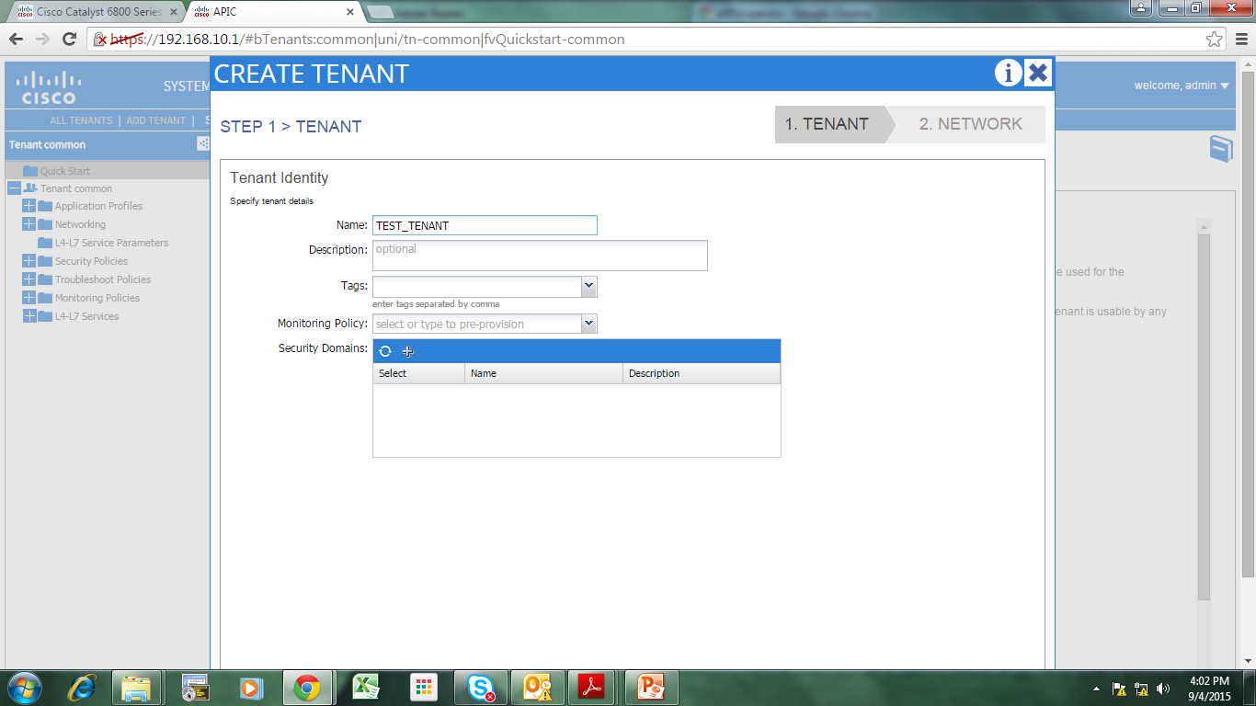
Adding a new Tenant

Slide 73
Adding a new Tenant
Set name
Click Next

Slide 74
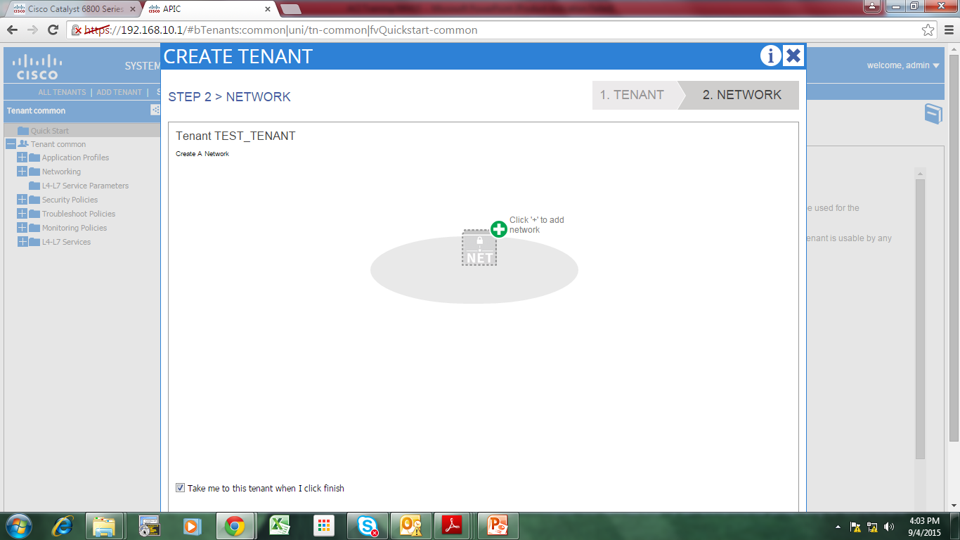
Adding a new Tenant

Slide 75
Adding a new Tenant
Click “+” to create a new network
Private network/network/Context/VRF are all the same in ACI.

Slide 76
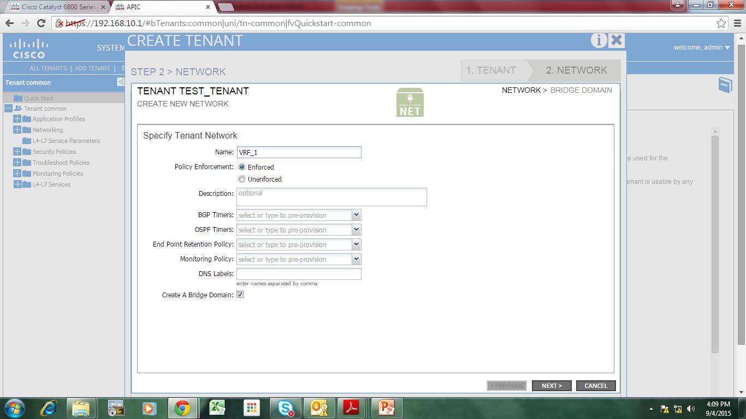
Adding a new Network/Context/VRF

Slide 77
Adding a new Network/Context/VRF
Set name
Tick the “Create Bridge Domain” checkbox
Click Next

Slide 78
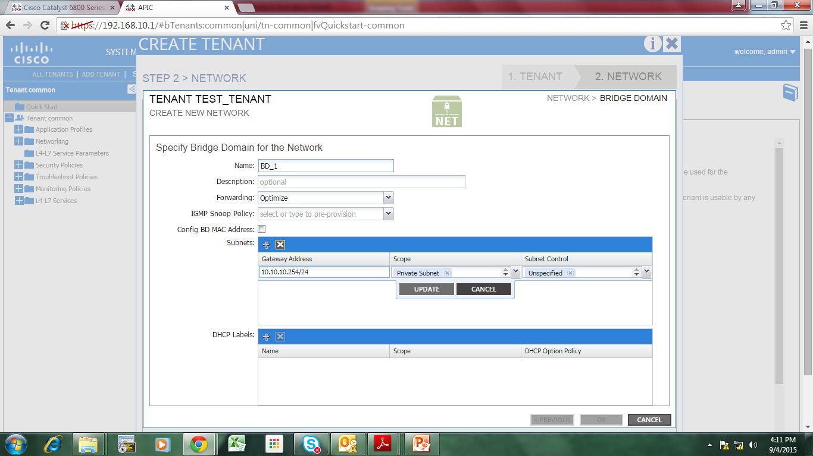
Adding a new Network/Context/VRF

Slide 79
Adding a new Bridge Domain
Set Bridge Domain name
Click on “+” for Subnets
Specify subnets under this Bridge Domain
  Gateway ip address and Subnet mask
Click Update
Click OK
Click FINISH
This Tenant will now appear on the Submenu of TENANTS

Slide 80
Create an Application Profile
Application Profile = Contains one or more EPG(s)
App Profile will pertain to an Application Server, whereas multiple EPGs will be used by this Server.

Slide 81
Create an Application Profile
Click TENANTS
Click <Tenant-name>
Click Application Profiles

Slide 82
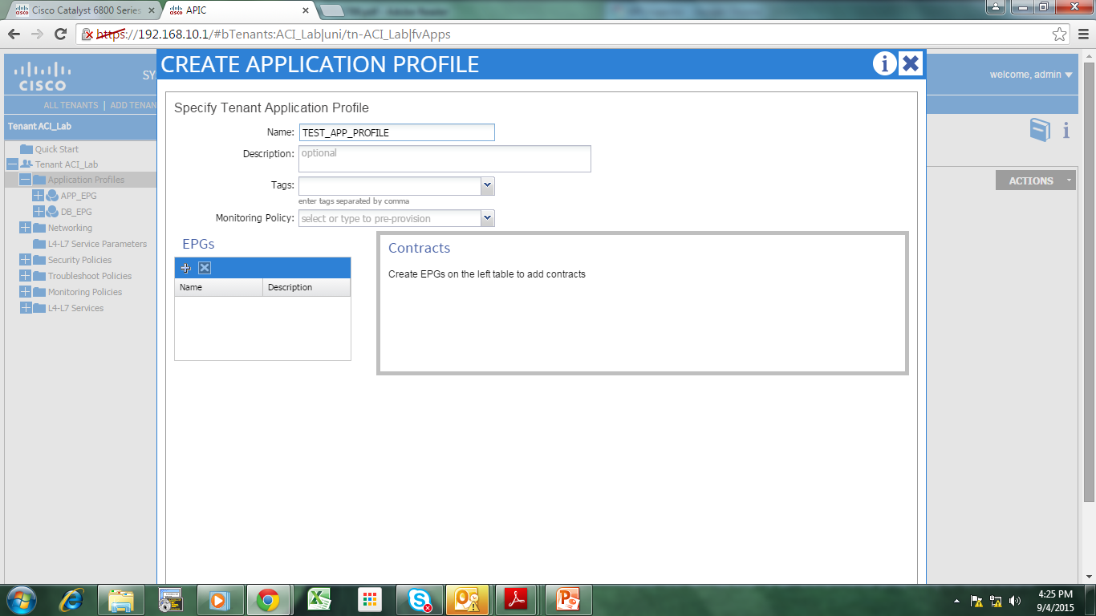

Slide 83
Create an Application EPG
EPG – End Point Group
EPG – Group of hosts that will have the same policies.

Slide 84
Create an Application EPG
Click on “+” on EPGs

Slide 85
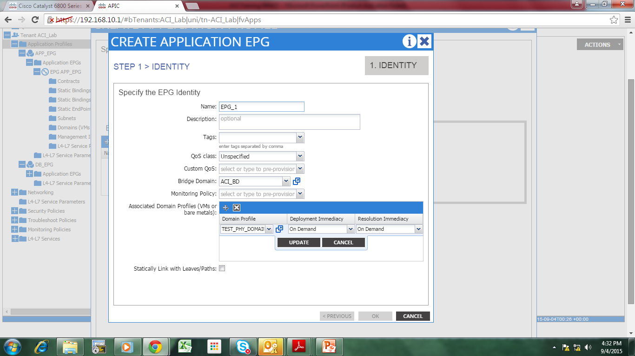
Create an Application EPG

Slide 86
Create an Application EPG
Set EPG name
Set the Bridge Domain you created earlier.
Set the Physical Domain you created earlier.
Click Update
Tick the “Statically link with Leaves/Paths”
  These are all optional for Traffic control
Click Next

Slide 87
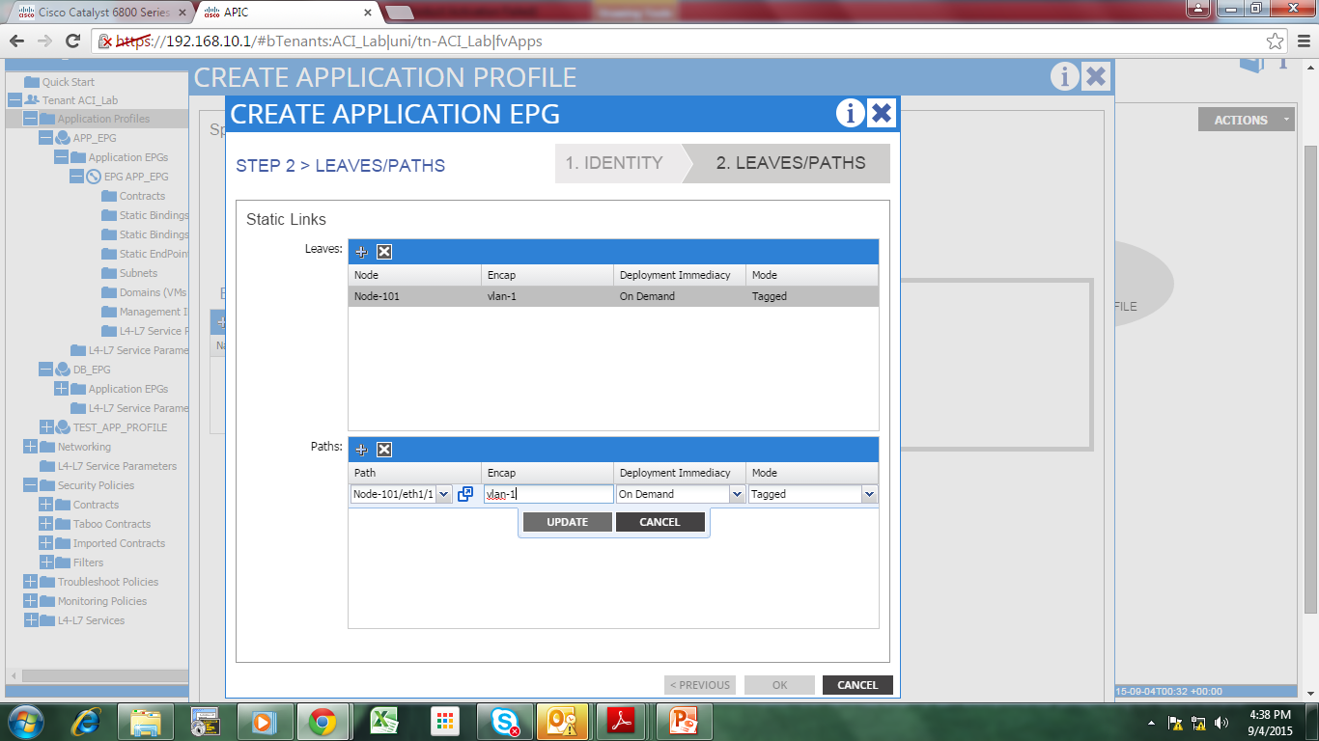
Create an Application EPG

Slide 88
Create an Application EPG
  VLAN should fall under range you defined earlier.
Click Update
Click OK

Slide 89
Connecting to External L2 Network

Slide 90
Connecting a Bridge Domain to an existing L2 network
Click Tenant
Go to Network Topology
Click Add L2 External
Create node profile
Create interface profile
Assign the interface that will connect as L2 external.

Slide 91
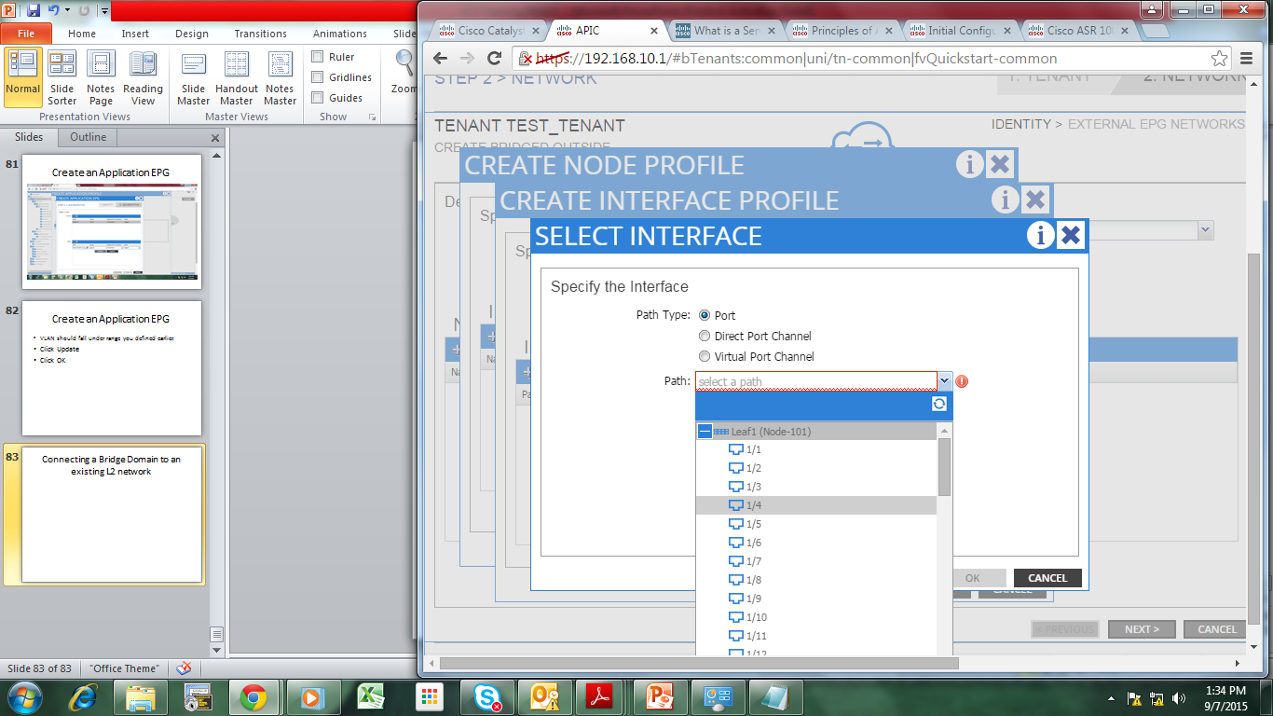

Slide 92
Things that can be set:
  Just as how you will connect a switch to another switch, you will set vlans allowed under the int.

Slide 93
Connecting to External L3 Network

Slide 94
Connecting ACI to an existing L3 network
Click Tenant
Go to Network Topology
Click Add L3 External
Create node profile
Create interface profile
Assign the interface that will connect as L3 external.

Slide 95
Integrating with VMWare

Slide 96
Steps
Create VMM Domain

Slide 97
Create a VMM Domain
Click VM Networking
Click Policies
Click VM Provider Vmware
Click Actions (or right click)
Click Create vCenter Domain

Slide 98
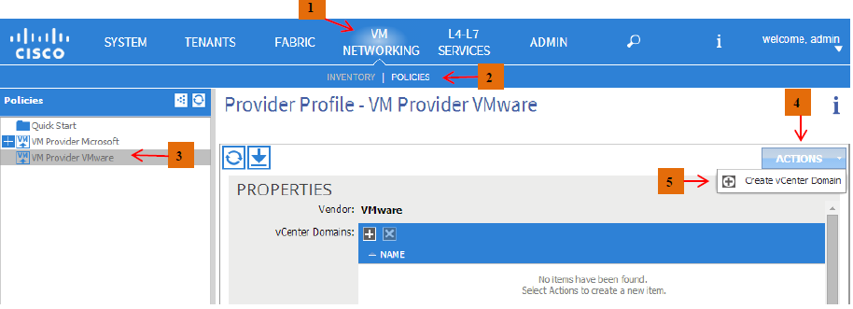
Create a VMM Domain

Slide 99
Create a VMM Domain
Click “+” on vCenter Domains

Slide 100
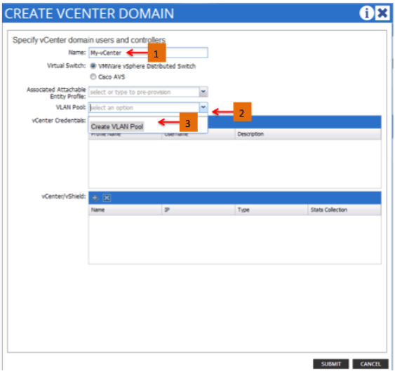
Create a VMM Domain

Slide 101
Set name
Set VLAN Pool (Create VLAN pool)

Slide 102
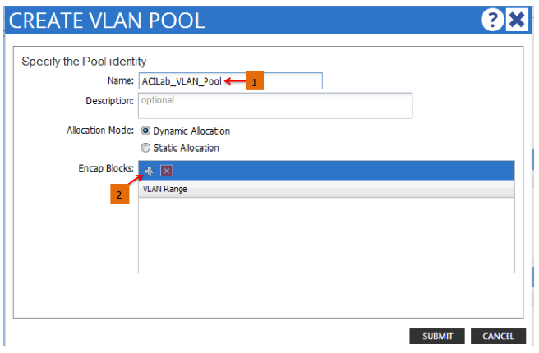
Create VLAN Pool

Slide 103
Create VLAN Pool
Set Name
Click Encap Blocks “+”
Set VLAN Range (From/To)
Click Ok
Click Submit
Click Create vCenter Credentials “+”

Slide 104
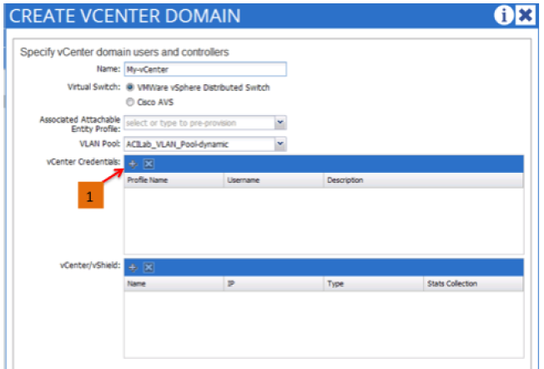
Create vCenter Credentials

Slide 105
Create vCenter Credentials
Set name
Set Username
Set Password
Click Ok

Slide 106
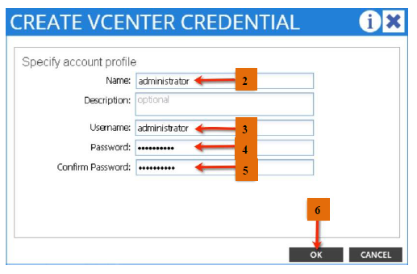
Create vCenter Credentials

Slide 107
Click vCenter/vShield

Slide 108
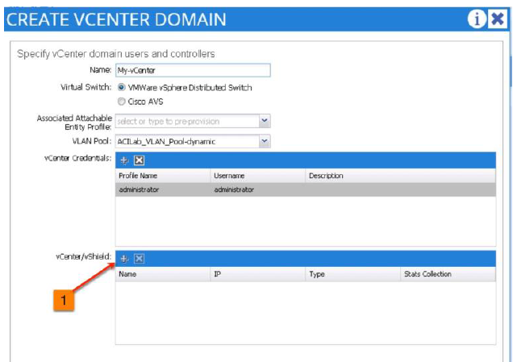

Slide 109
Set name
Set IP Address
Set Data Center name
Set Associated Credentials

Slide 110
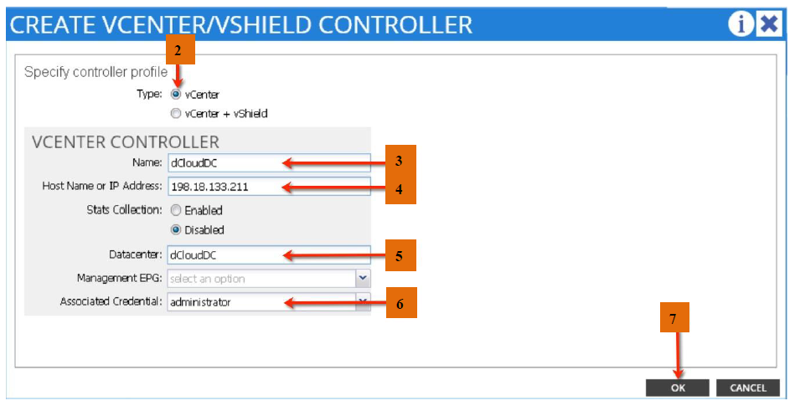

Slide 111
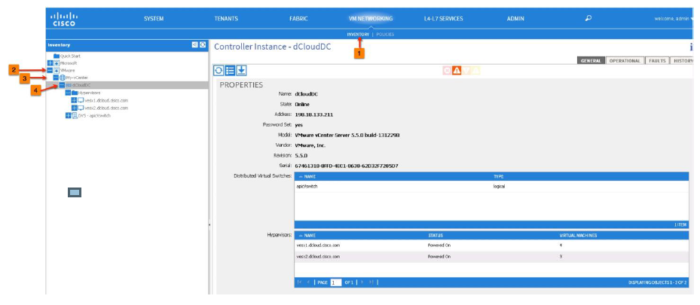
Verify

Slide 112
Verify
Click VM Networking
Click Inventory
Click VMware “+”
Click the created Vmware “+”
Expand and you will see the Hypervisors
*vSphere can also verify this by checking the APIC DVS created

Slide 113
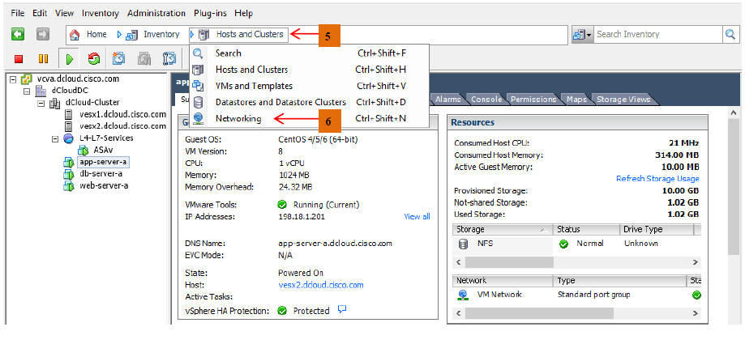

Slide 114
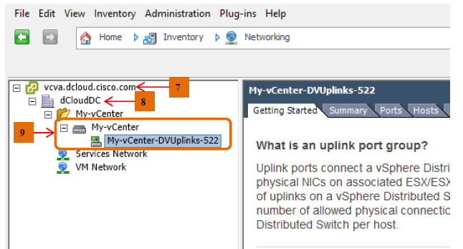

Slide 115
Adding an ESXi Host to APIC DVS

Slide 116
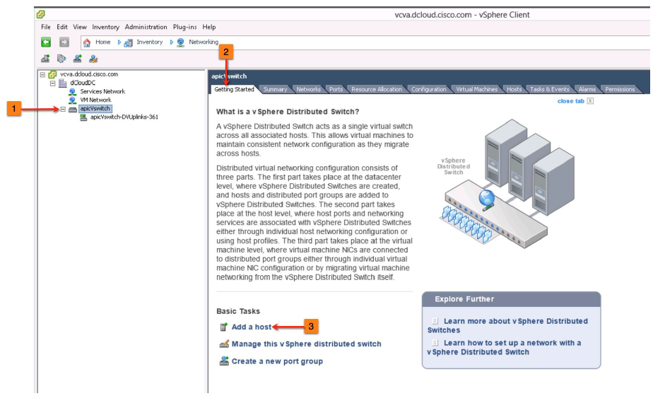

Slide 117
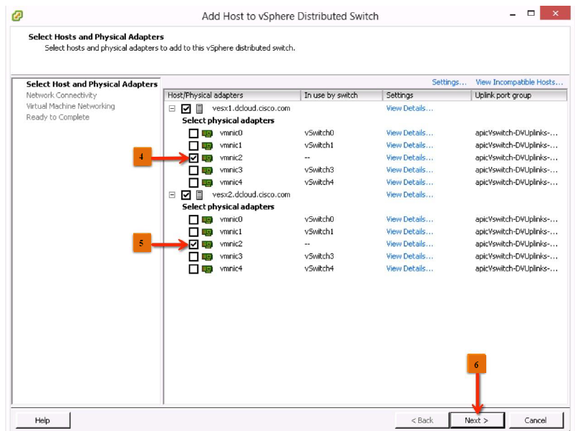

Slide 118
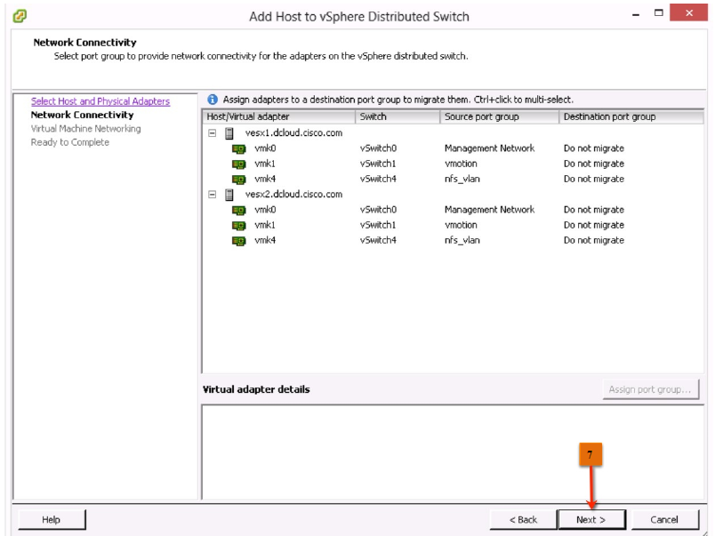

Slide 119
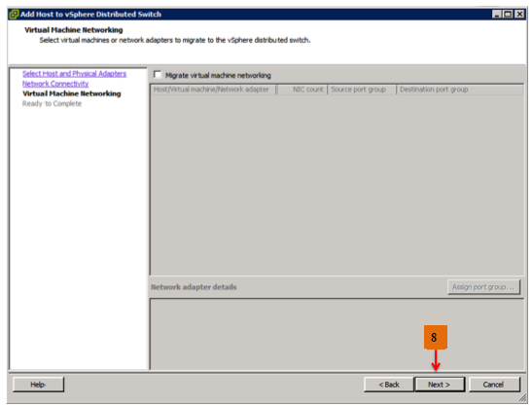

Slide 120
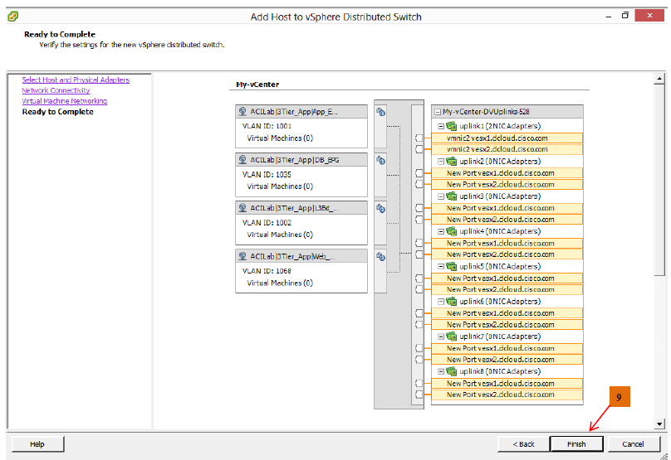

Slide 121
Integrating with F5

Slide 122
Integrating with Baremetal

Slide 123
ACI Management

Slide 124
Creating local User
Click on

Slide 125
REST API

Slide 126
Install Postman
Use Postman to GET or POST on ACI.

Slide 127
GET and POST
GET - is used to obtain sample API from GUI.
Can also be used to get output in text format similar to CLI.
POST – is used to do similar tasks in GUI. Advantage is when doing bulk and things that needs automation.

Slide 128
Example GET

Slide 129
Phyton

